Slide 1
Anti Theft Vehicle Tracking system Hardware Elements Extended Implementation
BeagleBone Black (ARM Cortex A8) (1GhZ Processor)
GPS Module
USB Camera
Power Circuit (Battery Charging circuit)
Motor Driving Circuit(Demo Purpose)
WiFi Module
Audio interface circuit(Mic & Signal conditioning circuit)

Slide 2
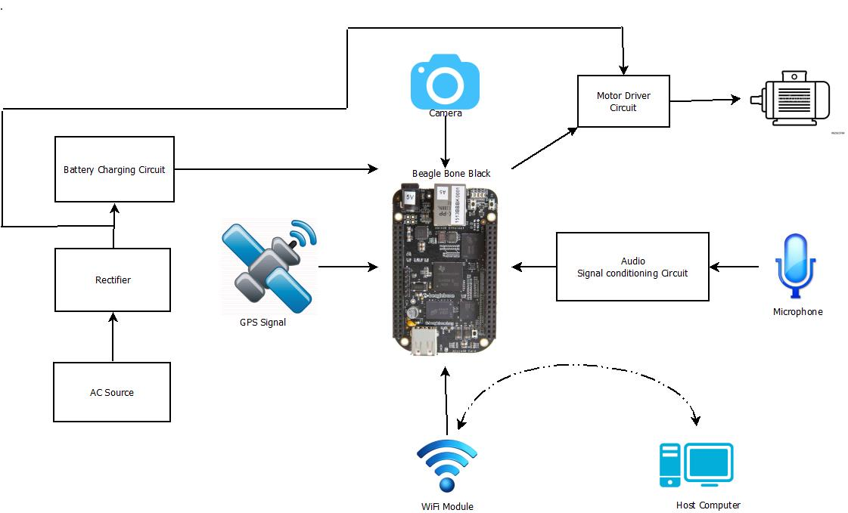
Block Diagram

Slide 3
SOFTWARE Extended Implementation
Driver for USB Camera
To acquire Image at 24 fps and store it in internal memory(OpenCV library)
Driver for GPS MODULE
To get the required longitude and latitude information (Python code)
User Interface
Using Linux Qt Libraries
Mic ( Analog signal to mp3 conversion)

Slide 4
Key Milestones
10/26
11/01
Available - Beagle Bone
10/28
Acquired all required components
Ordered other Components
Charging Unit for the system
Final Implementation
12/07
Build Audio interface circuit and software check
12/01
Wi Fi Implementation
11/23
Interface Camera and GPS module
11/07
11/15
Motor Driver circuit for Demo Application
User interface Development
Acquire frames and location
Converting Frames to Video

Slide 5
Project Deliverables Fall back plan
PCB Board (Battery Charging Circuit, Motor Driver Circuit)
Image Processing and GPS codes
User Interface in Linux
If continuous video streaming is not successful, Recorded video of 30 seconds or Frames will be transmitted
If communication through WiFi isn’t successful, Ethernet mode of communication will be implemented

